Slide 1
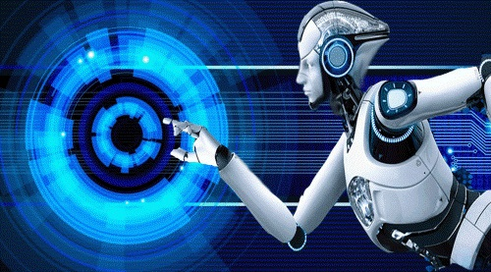
ARTIFICIAL INTELLIGENCE
Artificial Intelligence is composed of two words Artificial and Intelligence, where Artificial defines "man-made," and intelligence defines "thinking power", hence AI means "a man-made thinking power."

Slide 2
So, we can define AI as:
"It is a branch of computer science by which we can create intelligent machines which can behave like a human, think like humans, and able to make decisions.
Artificial Intelligence Definition
AI is branch of computer science which make computer / system to think like human being

Slide 3
Introduction to Artificial Intelligence
An intelligent entity created by humans.
Capable of performing tasks intelligently without being explicitly instructed.
Capable of thinking and acting rationally and humanely.
Artificial Intelligence exists when a machine can have human based skills such as learning, reasoning, and solving problems
With Artificial Intelligence you do not need to pre program a machine to do some work, despite that you can create a machine with programmed algorithms which can work with own intelligence, and that is the awesomeness of AI.
It is believed that AI is not a new technology, and some people says that as per Greek myth, there were Mechanical men in early days which can work and behave like humans.

Slide 4
Why Artificial Intelligence?
Before Learning about Artificial Intelligence, we should know that what is the importance of AI and why should we learn it. Following are some main reasons to learn about AI:
With the help of AI, you can create such software or devices which can solve real-world problems very easily and with accuracy such as health issues, marketing, traffic issues, etc.
With the help of AI, you can create your personal virtual Assistant, such as Cortana, Google Assistant, Siri, etc.
With the help of AI, you can build such Robots which can work in an environment where survival of humans can be at risk.
AI opens a path for other new technologies, new devices, and new Opportunities.

Slide 5
What Comprises to Artificial Intelligence?
Artificial Intelligence is not just a part of computer science even it's so vast and requires lots of other factors which can contribute to it. To create the AI first we should know that how intelligence is composed, so the Intelligence is an intangible part of our brain which is a combination of Reasoning, learning, problem-solving perception, language understanding, etc.
To achieve the above factors for a machine or software Artificial Intelligence requires the following discipline:
Mathematics
Biology
Psychology
Sociology
Computer Science
Neurons Study
Statistics

Slide 6
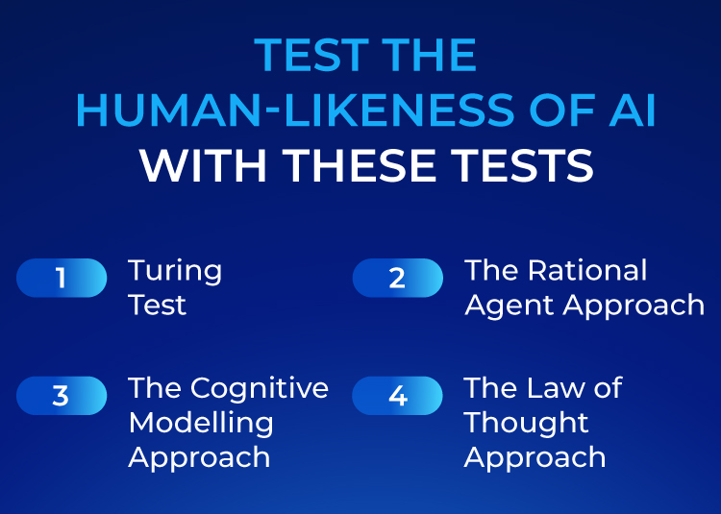

Slide 7
What is the Turing Test in Artificial Intelligence?
The basis of the Turing Test is that the Artificial Intelligence entity should be able to hold a conversation with a human agent. The human agent ideally should not able to conclude that they are talking to an Artificial Intelligence.

Slide 8
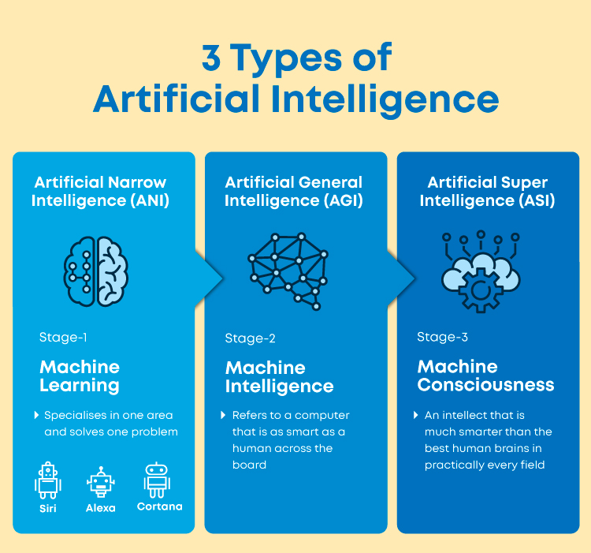
What are the Types of Artificial Intelligence?
3 Types of Artificial Intelligence
Artificial Narrow Intelligence (ANI)
Artificial General Intelligence (AGI)
Artificial Super Intelligence (ASI)

Slide 9
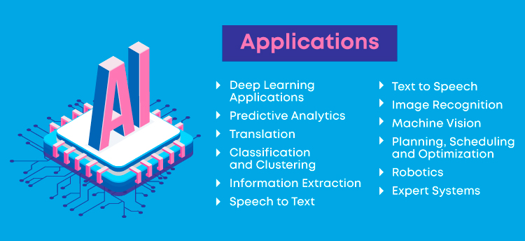
AI in Everyday life
Applications of Artificial Intelligence in business?
Online shopping
Digital personal assistants
Machine translations
Cybersecurity
Artificial intelligence against Covid-19

Slide 10
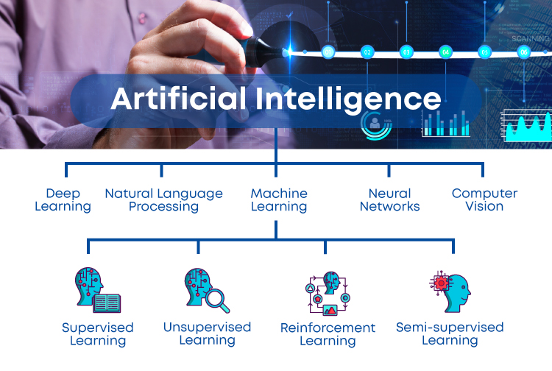

Slide 11
Top Used Applications in Artificial Intelligence
Google’s AI-powered predictions (E.g.: Google Maps)
Ride-sharing applications (E.g.: Uber, Lyft)
AI Autopilot in Commercial Flights
Spam filters on E-mails
Plagiarism checkers and tools
Facial Recognition
Search recommendations
Voice-to-text features
Smart personal assistants (E.g.: Siri, Alexa)
Fraud protection and prevention.

Slide 12
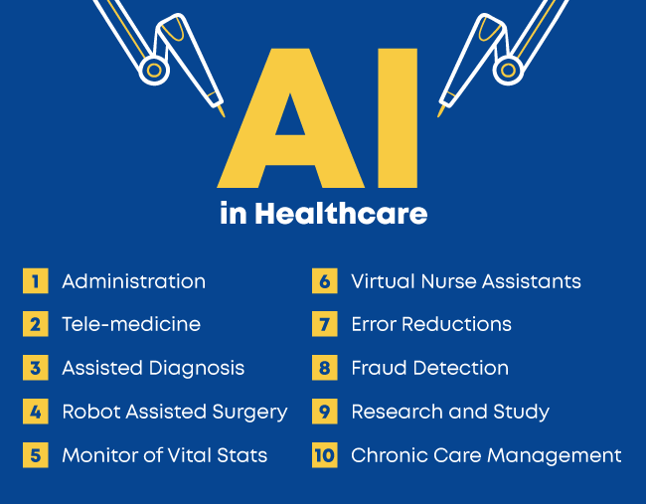

Slide 13
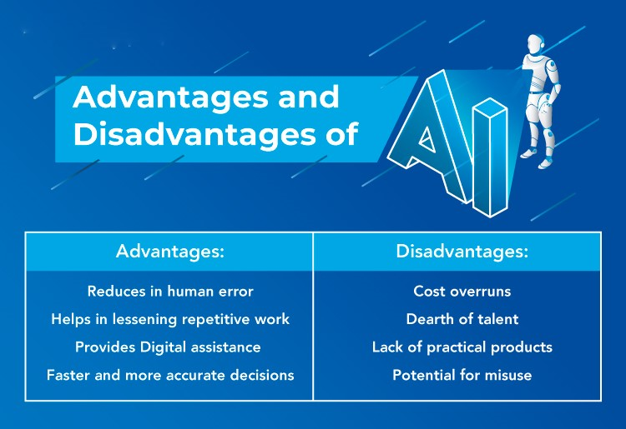

Slide 14
ARTIFICIAL INTELLIGENCE PROBLEMS
To understand AI, we can define some problems that we encounter in our daily life.
Almost all the problem stated in AI commonly uses the term STATE.
It defines the state of the solution for given problem at that particular step.
In short , the solution of a problem by a collection of the problem state.
The problem solving procedure used is to apply an operator to a state to get the next state.
The process of deriving a new state from the current state by applying the operator till desired state is reached is called State space approach

Slide 15
The Study area of AI
It Involves the various Knowledge Representation schemes.
Intelligent search methods
Techniques for automating machine learning.
The Various Application field Include
Expert system
Image recognition , Game playing
Theorem Proving
Natural Language processing and Robotics

Slide 16
AI- Problems and how it is differ from other
If a problem need symbolic representation in computer
If there is combinational explosion in out putting
8 queen problem
Travelling sales man problem
Fuzzy set for un characterize data
The Knowledge base of an AI problem is Voluminous.
The data or Knowledge base is Changing fast
Doing work with out tiredness and fatigue.

Slide 17
Characteristics of AI – How the Problem is analyzed
Is the problem decomposable or not
Can the solution steps be ignored
Is the solution is universe predictable
Is the solution to a problem is absolute or relative
Is the knowledge base consistent or not
The role of the knowledge
Is the interaction with computer is Necessary.

Slide 18
Topics of AI
In Text Book
Learning Systems
Knowledge representation and reasoning
Planning
Knowledge Acquisition
Intelligent Search
Logic Programming
Soft Computing
Management of imprecision and Uncertainty
In General
Machine learning
Neural Networks
Computer Vision
Robotics
Experts Systems
Speech processing
Natural Language processing
Problem Solving

Slide 19
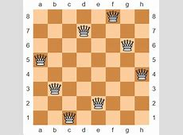
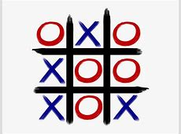

Slide 20
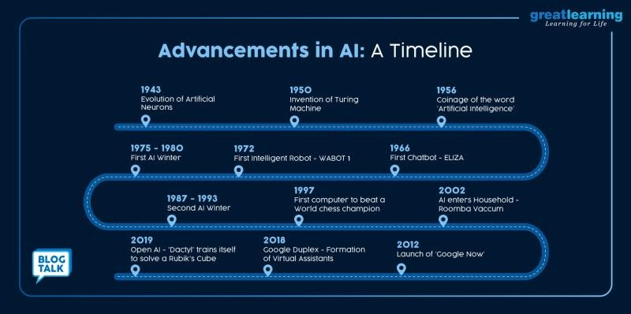

Slide 21
Time Lines of Artificial Intelligence
Artificial intelligence requires the ability to learn and make decisions, often based on incomplete information. In 1763, Thomas Bayes developed a framework for reasoning about the probability of events, using math to update the probability of a hypothesis as more information becomes available.
Bayesian inference would become an important approach in machine learning, and marks one of the earliest milestones on our artificial intelligence timeline

Slide 22
From numbers to poetry (1842)
In 1842, English mathematician Ada Lovelace was helping Charles Babbage publish the first algorithm to be carried out by his Analytical Engine, the first general-purpose mechanical computer.
She envisioned a computer that could crunch not just numbers, but solve problems of any complexity.
At the time it was revolutionary that machines have applications beyond pure calculation. She called the idea Poetical Science

Slide 23
“Robot” enters vernacular (1921)
Czech writer Karel Čapek introduces the word "robot" in his play R.U.R. (Rossum's Universal Robots). The word "robot" comes from the word "robota" (work or slave).
World War 2 triggers fresh thinking (1942)
World War Two brought together scientists from many disciplines, including the emerging fields of neuroscience and computing. In Britain, mathematician Alan Turing and neurologist Grey Walter were two of the bright minds who tackled the challenges of intelligent machines.

Slide 24
Neurons go artificial (1943)
Warren S. McCulloch and Walter Pitts publish “A Logical Calculus of the Ideas Immanent in Nervous Activity” in the Bulletin of Mathematical Biophysics
Can a machine think? (1949)
“Recently there have been a good deal of news about strange giant machines that can handle information with vast speed and skill….These machines are similar to what a brain would be if it were made of hardware and wire instead of flesh and nerves… A machine can handle information; it can calculate, conclude, and choose; it can perform reasonable operations with information. A machine, therefore, can think.”

Slide 25
Science fiction steers the conversation (1950)
In 1950, “I Robot” was published – a collection of short stories by science fiction writer Isaac Asimov.
“Machine learning” coined (1959)
Arthur Samuel coins the term “machine learning,” reporting on programming a computer “so that it will learn to play a better game of checkers than can be played by the person who wrote the program.” This marks a historic point in our artificial intelligence timeline, with the coining of a phrase that will come to embody an entire field within AI.

Slide 26
Tough problems to crack (1969)
Shakey was the first general-purpose mobile robot able to make decisions about its own actions by reasoning about its surroundings. It built a spatial map of what it saw, before moving.
But it was painfully slow, even in an area with few obstacles. Each time it nudged forward, Shakey would have to update its map.
A moving object in its field of view could easily bewilder it, sometimes stopping it in its tracks for an hour while it planned its next move.

Slide 27
A.L.I.C.E. chatbot learns how to speak from the web (1995)
Man vs. machine: fight of the 20th century (1997)
The first robot for the home (2002)
Starting to crack the big problems (2008)
Dance bots (2010)
Man vs machine: fight of the 21st century (2011)
Learning cat faces (2012)
The painting fool (2013)
Are machines intelligent now? (2014)
Partnership on AI (2016)
Google Deep Dream is born (2015)
AI co-produces mainstream pop album (2017)

Slide 28
Production Systems
What is Production system ?
Production system or production rule system is a computer program typically used to provide some form of artificial intelligence, which consists primarily of a set of rules about behavior but it also includes the mechanism necessary to follow those rules as the system responds to states of the world.
In Simple Production system in AI contains a set of rules which are defined by the left side (Conditions) and the right side contains the things to do (action )
.

Slide 29
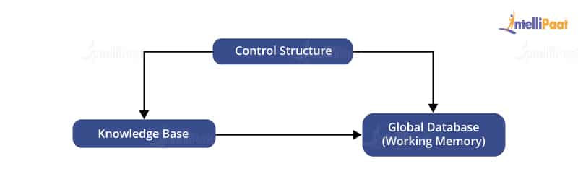
Components of Production System

Slide 30
Components of Production System
Global Database: The global database is the central data structure used by the production system in Artificial Intelligence.
Set of Production Rules: The production rules operate on the global database. Each rule usually has a precondition that is either satisfied or not by the global database. If the precondition is satisfied, the rule is usually be applied. The application of the rule changes the database.
A Control System: The control system then chooses which applicable rule should be applied and ceases computation when a termination condition on the database is satisfied. If multiple rules are to fire at the same time, the control system resolves the conflicts

Slide 31
Features of Production Systems
1. Simplicity: The structure of each sentence in a production system is unique and uniform as they use the “IF-THEN” structure. This structure provides simplicity in knowledge representation. This feature of the production system improves the readability of production rules.
2. Modularity: This means the production rule code the knowledge available in discrete pieces. Information can be treated as a collection of independent facts which may be added or deleted from the system with essentially no deleterious side effects.
3. Modifiability: This means the facility for modifying rules. It allows the development of production rules in a skeletal form first and then it is accurate to suit a specific application.
4. Knowledge-intensive: The knowledge base of the production system stores pure knowledge. This part does not contain any type of control or programming information. Each production rule is normally written as an English sentence.

Slide 32
Control/Search Strategies
How would you decide which rule to apply while searching for a solution for any problem? There are certain requirements for a good control strategy that you need to keep in mind, such as.
The first requirement for a good control strategy is that it should cause motion.
The second requirement for a good control strategy is that it should be systematic.
Finally, it must be efficient in order to find a good answer.

Slide 33
Classes of a Production System
There are four types of production systems
1. Monotonic Production System
In this type of a production system, the rules can be applied simultaneously as the use of one rule does not prevent the involvement of another rule that is selected at the same time
2. Partially Commutative Production System
This class helps create a production system that can give the results even by interchanging the states of rules. If using a set of rules transforms State A into State B, then multiple combinations of those rules will be capable to convert State A into State B.

Slide 34
3. Non-monotonic Production System
This type of a production system increases efficiency in solving problems. The implementation of these systems does not require backtracking to correct the previous incorrect moves. The non-monotonic production systems are necessary from the implementation point of view to find an efficient solution.
4. Commutative System
Commutative systems are helpful where the order of an operation is not important. Also, problems where the changes are reversible use commutative systems. On the other hand, partially commutative production systems help in working on problems, where the changes are irreversible such as a chemical process. When dealing with partially commutative systems, the order of processes is important to get the correct results.

Slide 35
Production System Rules
Deductive Inference Rules
Abductive Inference Rules

Slide 36

Production System in Artificial Intelligence: Example
Problem Statement:
We have two jugs of capacity 5l and 3l (liter), and a tap with an endless supply of water. The objective is to obtain 4 liters exactly in the 5-liter jug with the minimum steps possible
Production System:
Fill the 5 liter jug from tap
Empty the 5 liter jug
Fill the 3 liter jug from tap
Empty the 3 liter jug
Then, empty the 3 liter jug to 5 liter
Empty the 5 liter jug to 3 liter
Pour water from 3 liters to 5 liter
Pour water from 5 liters to 3 liters but do not empty
Solution:
1,8,4,6,1,8 or 3,5,3,7,2,5,3,5;

Slide 37


Slide 38
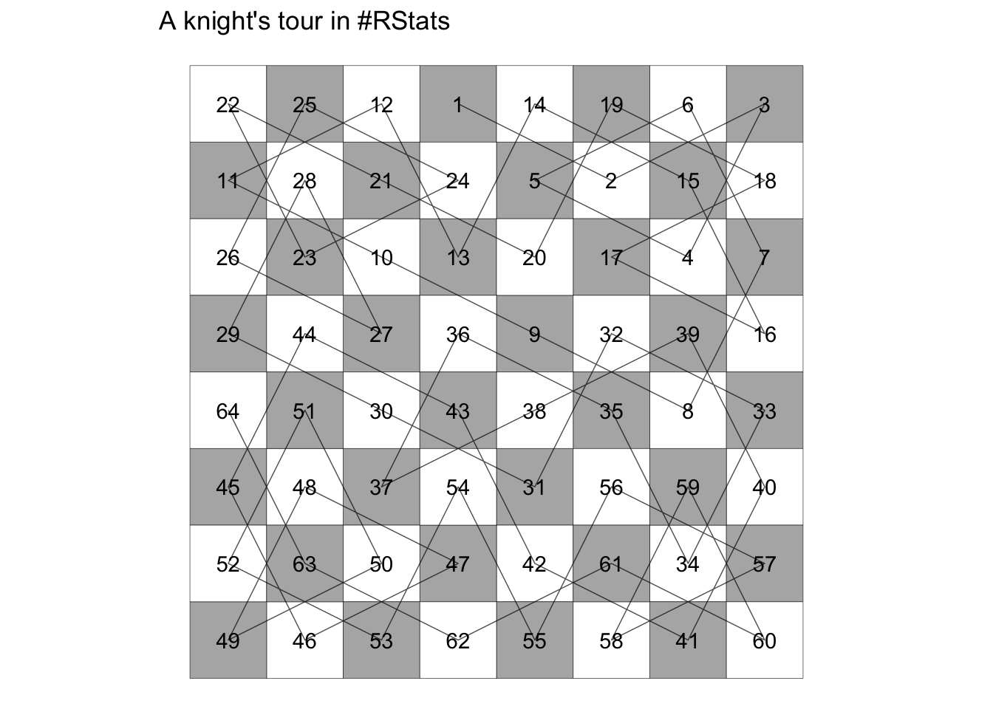
The Knight’s Tour Problem

Slide 39
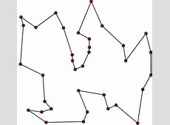
Travelling Sales Man Problem

Slide 40
Advantages
Some of the advantages of Production system in artificial intelligence are:
Provides excellent tools for structuring AI programs
The system is highly modular because individual rules can be added, removed or modified independently
Separation of knowledge and Control-Recognises Act Cycle
A natural mapping onto state-space research data or goal-driven
The system uses pattern directed control which is more flexible than algorithmic control
Provides opportunities for heuristic control of the search
A good way to model the state-driven nature of intelligent machines
Quite helpful in a real-time environment and applications

Slide 41
Disadvantages
It is very difficult to analyze the flow of control within a production system
It describes the operations that can be performed in a search for a solution to the problem.
There is an absence of learning due to a rule-based production system that does not store the result of the problem for future use.
The rules in the production system should not have any type of conflict resolution as when a new rule is added to the database it should ensure that it does not have any conflict with any existing rule.

Slide 42
State Space Representation
State Space search
Tic Tac Toe as a state space
8 tile puzzle
Tower of Hannoi
The Missionaries and Cannibals problem

Slide 43
State Space search
It is complete set of states including start and goal states, where the answer of the problem is to be searched”.
State space search is a process used in the field of computer science, including artificial intelligence (AI), in which successive configurations or states of an instance are considered, with the goal of finding a goal state with a desired property.

Slide 44
Before an AI problem can be solved it must be represented as a state space
The state space is then searched to find a solution to the problem.
A state space essentially consists of a set of nodes representing each state of the problem, arcs between nodes representing the legal moves from one state to another, an initial state and a goal state.
Each state space takes the form of a tree or a graph
Factors that determine which search algorithm or technique will be used include the type of the problem and the how the problem can be represented.

Slide 45
Defining State & Search Space
A state is a representation of problem elements at a given moment.
A State space is the set of all states reachable from the initial state.
A state space forms a graph in which the nodes are states and the arcs between nodes are actions.
In the state space, a path is a sequence of states connected by a sequence of actions.
The solution of a problem is part of the graph formed by the state space.

Slide 46
Problem
“It is the question which is to be solved. For solving the problem it needs to be precisely defined. The definition means, defining the start state, goal state, other valid states and transitions”.
A state space representation allows for the formal definition of a problem which makes the movement from initial state to the goal state quite easily.
So we can say that various problems like planning, learning, theorem proving etc. are all essentially search problems only.

Slide 47

For Example:
The eight tile puzzle problem formulation
The eight tile puzzle consist of a 3 by 3 (3*3) square frame board which holds 8 movable tiles numbered 1 to 8. One square is empty, allowing the adjacent tiles to be shifted. The objective of the puzzle is to find a sequence of tile movements that leads from a starting configuration to a goal configuration

Slide 48
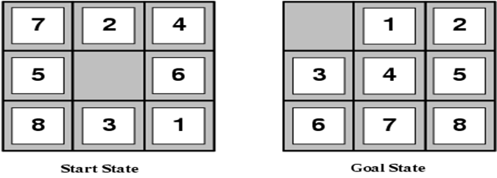
states? locations of tiles
actions? move blank left, right, up, down
goal test? = goal state (given)
path cost? 1 per move

Slide 49
The states of 8 tile puzzle
Lets do a standard formulation of this problem now.
States: It specifies the location of each of the 8 tiles and the blank in one of the nice squares.
Initial state : Any state can be designated as the initial state.
Goal : Many goal configurations are possible one such is shown in the figure
Legal moves ( or state) :
They generate legal states that result from trying the four actions-
Blank moves left
Blank moves right
Blank moves up
Blank moves down
Path cost: Each step costs 1, so the path cost is the number of steps in the path

Slide 50
Concepts for defining a Game Tree:
A Game Tree is a structure for organizing all possible (legal) game states by the moves which allow transition from one game state to the next.
This structure helps the computer to evaluate which moves to make because, by traversing the game tree, a computer (program) can easily see the outcome of a move and can decide whether to take it or not.

Slide 51
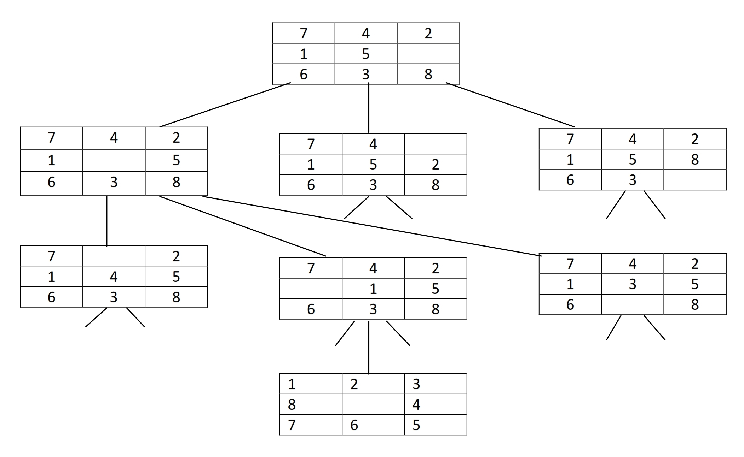

Slide 52
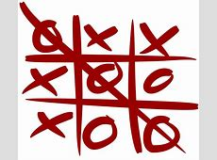
TIC TAC TOE
The first Game State will show nine moves, one for each of the empty spaces on its board.
Similarly, the next level of Game States will show eight moves and continues for each Game State.
The computer evaluates each of its current possible moves by representing the game as a game tree. This also helps to determine whether it will result into a win or a loss.

Slide 53
The following states are used to represent a game tree
1. The board state: This is an initial stage. 2. The current player: It refers to the player who will be making the next move. 3. The next available moves: For humans, a move involves placing a game token while the computer selects the next game state. 4. The game state: It includes the grouping of the three previous concepts. 5.Final Game States In final game states, AI should select the winning move in such a way that each move assigns a numerical value based on its board state.

Slide 54
Missionaries and Cannibals
Missionaries and Cannibals problem is very famous in Artificial Intelligence
Three missionaries and three cannibals are on one side of a river, along with a boat that can hold one or two people.
Now we have to find a way to get everyone to the other side, without ever leaving a group of missionaries in one place outnumbered by the cannibals in another side.

Slide 55
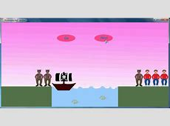

Slide 56
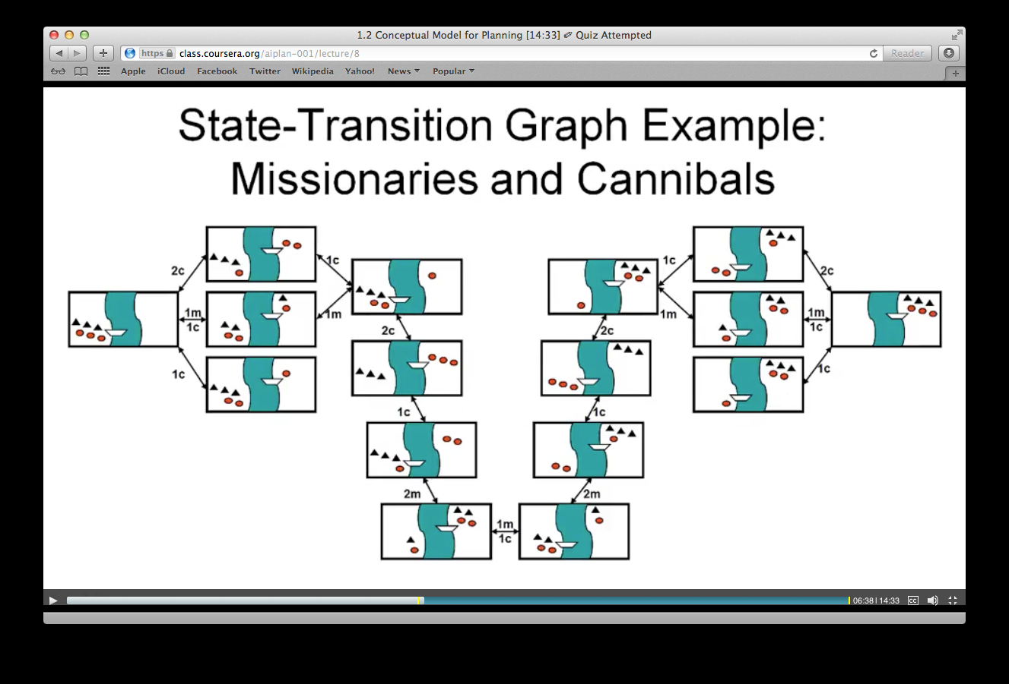

Slide 57
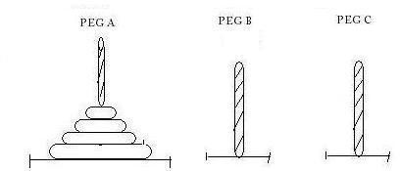
THE TOWER OF HANOI PROBLEM

Slide 58
Prefacing Artificial intelligence
In terms of easy definition, Artificial Intelligence is the capability of a machine or computer device to emulate human intelligence (cognitive process), acquire from experiences, adapt to the latest information and operate humans-like-activities.
Artificial Intelligence executes tasks intelligently that yield in generating huge accuracy, adaptability, and productivity for the entire system. Tech decision-makers are seeking many ways to adequately implement artificial intelligence technologies into their businesses to draw interference and add values to them.

Slide 59
Branches of Artificial Intelligence
Machine learning
Neural Network
Robotics
Expert Systems
Fuzzy Logic
Natural Language Processing

Slide 60
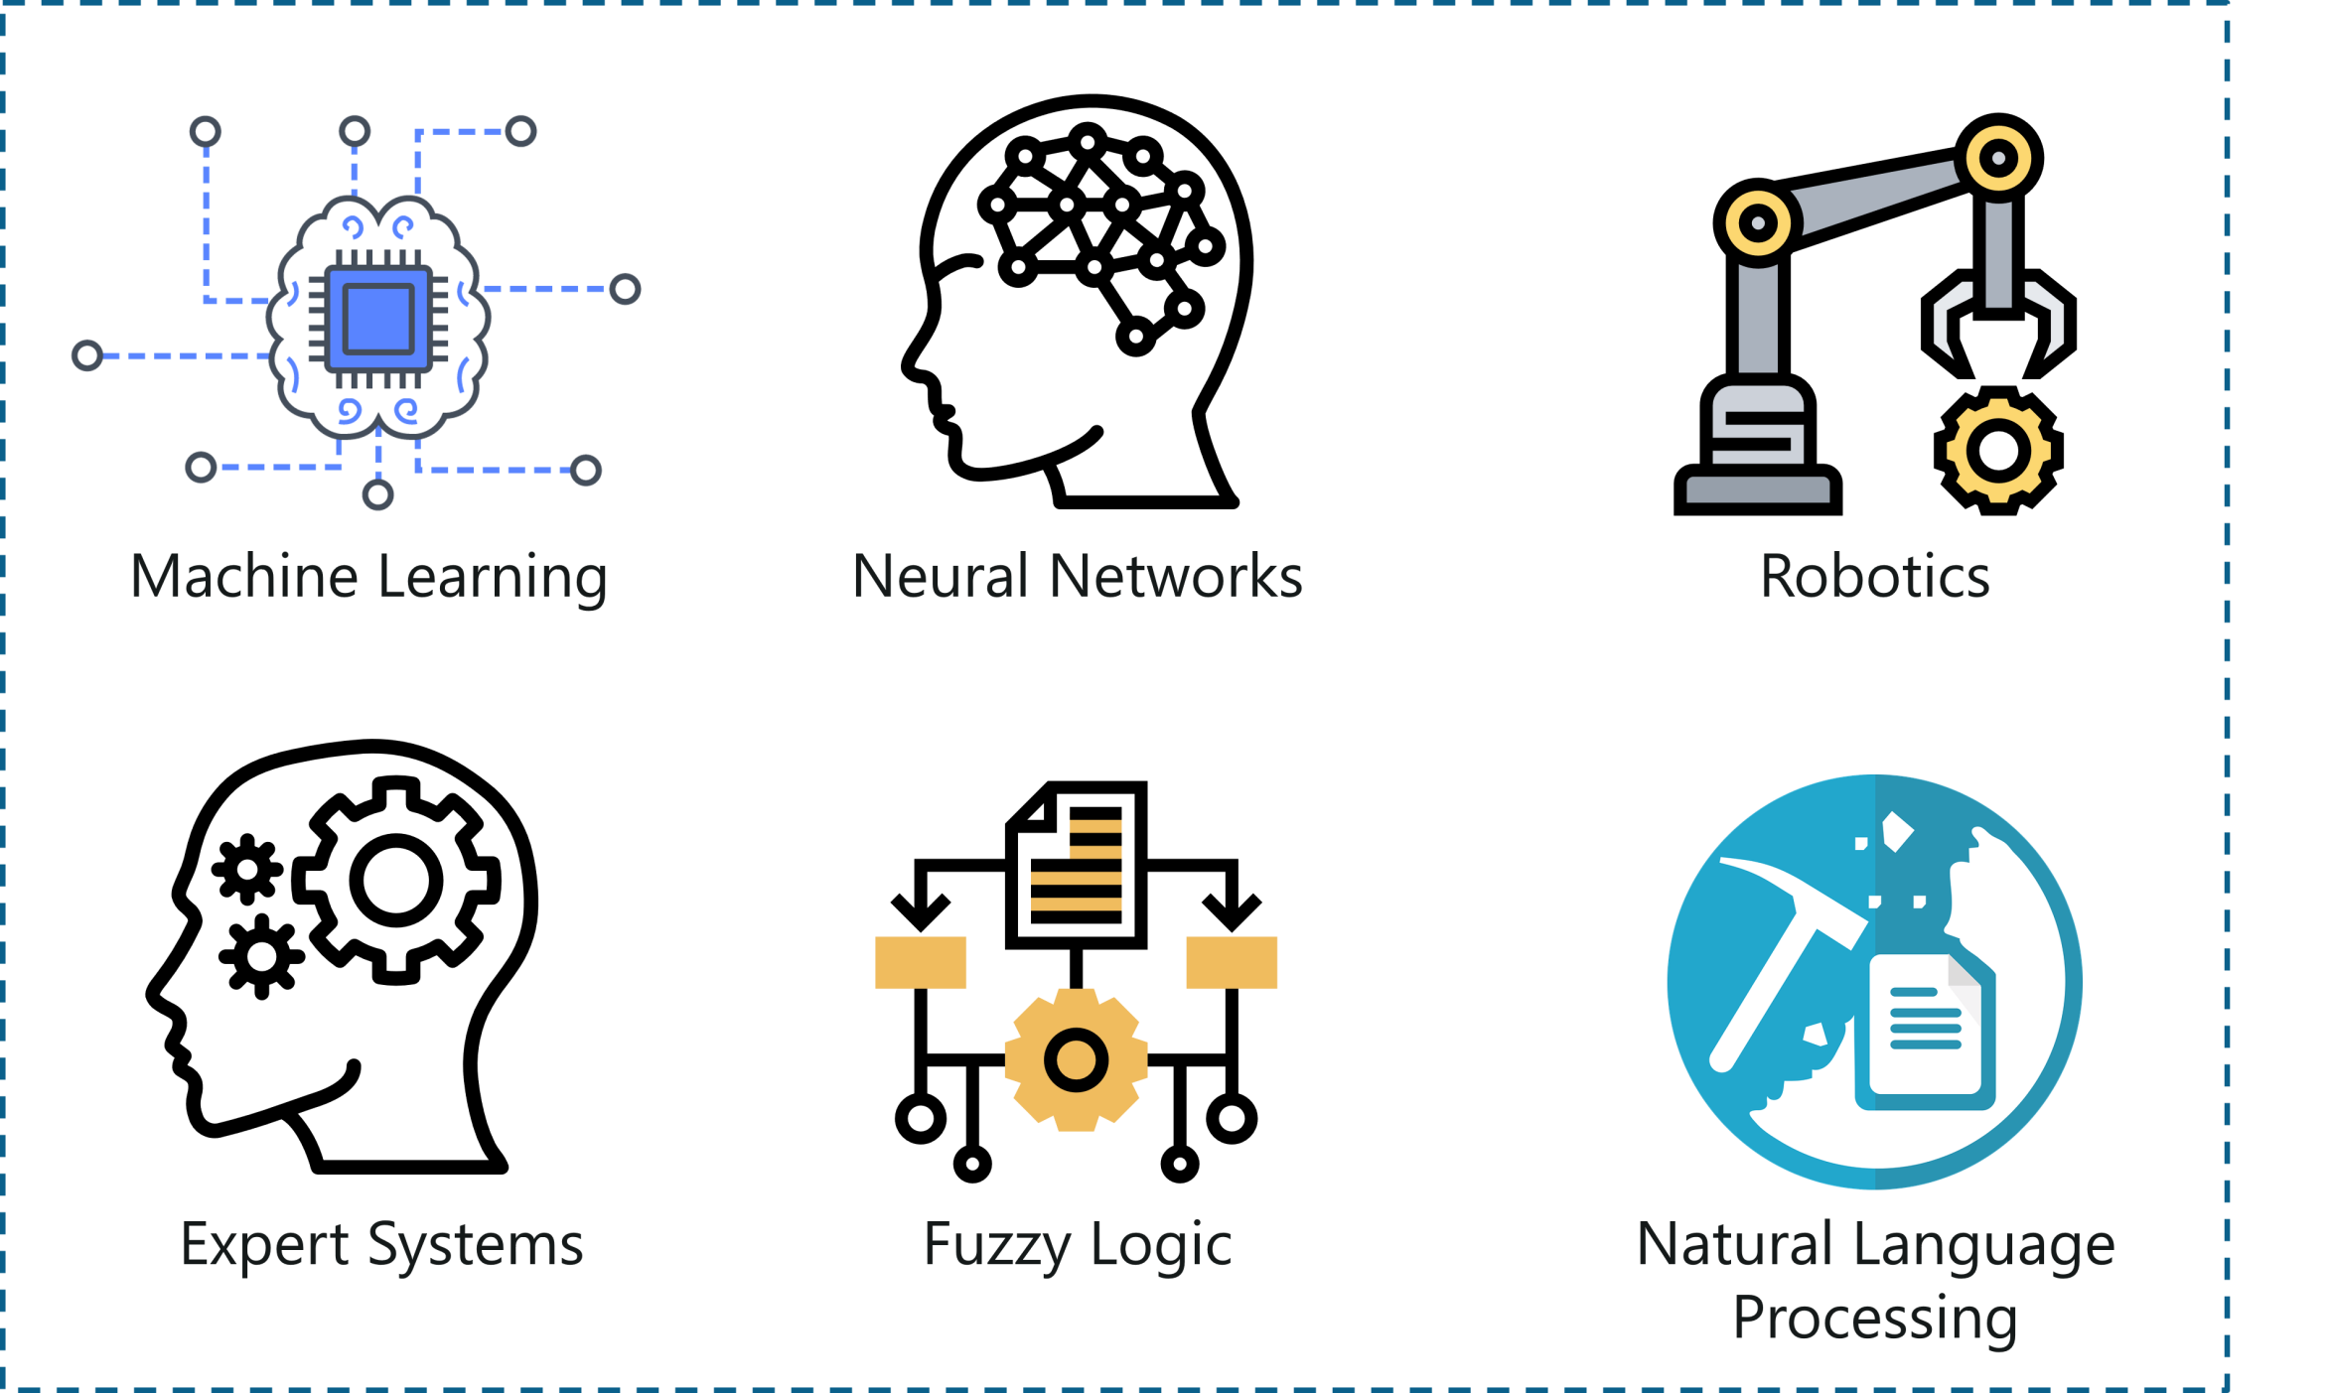

Slide 61
Machine learning
Machine Learning is the technique that gives computers the potential to learn without being programmed, it is actively being used in daily life, machine learning applications in daily life, even without knowing that. Fundamentally, it is the science that enables machines to translate, execute and investigate data for solving real-world problems.

Slide 62
Types of machine learning
Supervised Learning: In this type of learning, data experts feed labelled training data to algorithms and define variables to algorithms for accessing and finding correlations. Both the input and output of the algorithm are particularized/defined.
Unsupervised Learning: This type of learning include algorithms that train on unlabelled data, an algorithm analyzes datasets to draw meaningful correlations or inferences. For example, one method is cluster analysis that uses exploratory data analysis to obtain hidden or grouping patterns or groups in datasets.
Reinforcement Learning: For teaching a computer machine to fulfil a multi-step process for which there are clearly defined rules, reinforcement learning is practised. Here, programmers design an algorithm to perform a task and give it positive and negative signal to act as algorithm execute to complete the task. Sometimes, the algorithm even determines on its own what action to take to go ahead.

Slide 63
Neural Network
In simple terms, a neural network is a set of algorithms that are used to find the elemental relationships across the bunches of data via the process that imitates the human brain operating process.
Neural network replicates the human brain where the human brain comprises an infinite number of neurons and to code brain-neurons into a system or a machine is what the neural network functions

Slide 64
Robotics
Robotics is an interdisciplinary field of science and engineering incorporated with mechanical engineering, electrical engineering, computer science, and many others.
Robotics determines the designing, producing, operating, and usage of robots. It deals with computer systems for their control, intelligent outcomes, and information transformation

Slide 65
Expert Systems
An expert system refers to a computer system that mimics the decision-making intelligence of a human expert. It conducts this by deriving knowledge from its knowledge base by implementing reasoning and insights rules in terms with the user queries.
The effectiveness of the expert system completely relies on the expert’s knowledge accumulated in a knowledge base. The more the information collected in it, the more the system enhances its efficiency. For example, the expert system provides suggestions for spelling and errors in Google Search Engine

Slide 66
Fuzzy Logic
In the real world, sometimes we face a condition where it is difficult to recognize whether the condition is true or not, their fuzzy logic gives relevant flexibility for reasoning that leads to inaccuracies and uncertainties of any condition.
It is simply the generalization of the standard logic where a concept exhibits a degree of truth between 0.0 to 1.0. If the concept is completely true, standard logic is 1.0 and 0.0 for the completely false concept. But in fuzzy logic, there is also an intermediate value too which is partially true and partially false.

Slide 67
Natural Language Processing
NLP is the part of computer science and AI that can help in communicating between computer and human by natural language. It is a technique of computational processing of human languages. It enables a computer to read and understand data by mimicking human natural language
NLP is a method that deals in searching, analyzing, understanding and deriving information from the text form of data. In order to teach computers how to extract meaningful information from the text data, NLP libraries are used by programmers. A common example of NLP is spam detection, computer algorithms can check whether an email is a junk or not by looking at the subject of a line, or text of an email.

Slide 68
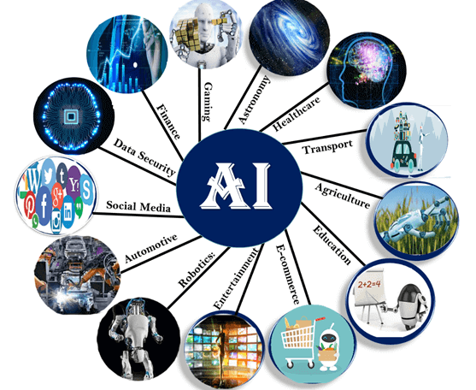
Applications of Artificial Intelligence
Artificial Intelligence has various applications in today's society. It is becoming essential for today's time because it can solve complex problems with an efficient way in multiple industries, such as Healthcare, entertainment, finance, education, etc. AI is making our daily life more comfortable and fast.

Slide 69
AI in Healthcare
In the last, five to ten years, AI becoming more advantageous for the healthcare industry and going to have a significant impact on this industry.
Healthcare Industries are applying AI to make a better and faster diagnosis than humans. AI can help doctors with diagnoses and can inform when patients are worsening so that medical help can reach to the patient before hospitalization.
Faster diagnosis using patient’s health data and other related data (IBM’s Watson)
Medical images scanning for the detection of diseases.
Clinical Decision support system using data mining
Robot to do repetitive jobs in surgery and patient care

Slide 70
AI in Astronomy
Artificial Intelligence can be very useful to solve complex universe problems. AI technology can be helpful for understanding the universe such as how it works, origin, etc.
AI in Gaming
AI can be used for gaming purpose. The AI machines can play strategic games like chess, where the machine needs to think of a large number of possible places.

Slide 71
AI in Finance
AI and finance industries are the best matches for each other. The finance industry is implementing automation, chatbot, adaptive intelligence, algorithm trading, and machine learning into financial processes.
AI in Data Security
The security of data is crucial for every company and cyber-attacks are growing very rapidly in the digital world. AI can be used to make your data more safe and secure. Some examples such as AEG bot, AI2 Platform, are used to determine software bug and cyber-attacks in a better way.

Slide 72
AI in Social Media
Social Media sites such as Facebook, Twitter, and Snapchat contain billions of user profiles, which need to be stored and managed in a very efficient way. AI can organize and manage massive amounts of data. AI can analyze lots of data to identify the latest trends, hashtag, and requirement of different users.
AI in Travel & Transport
AI is becoming highly demanding for travel industries. AI is capable of doing various travel related works such as from making travel arrangement to suggesting the hotels, flights, and best routes to the customers. Travel industries are using AI-powered chatbots which can make human-like interaction with customers for better and fast response.

Slide 73
Transportation
Drivers are facilitated with AI features like self-parking, advanced cruise controls to assist them.
AI techniques are used in improving traffic management system that reduces wait times, fuel consumption and emissions by 25%
Automatic transmission system
A driverless (Autonomous) car is in a pilot stage.
Manufacturing
Robot in manufacturing in non-ergonomic conditions.
Predictive smart maintenance to avoid production loss
Early alert on probable quality issues in manufacturing line due to machine behavior or raw material quality etc.,

Slide 74
AI in Automotive Industry
Some Automotive industries are using AI to provide virtual assistant to their user for better performance. Such as Tesla has introduced TeslaBot, an intelligent virtual assistant.
Various Industries are currently working for developing self-driven cars which can make your journey more safe and secure.
AI in Entertainment
We are currently using some AI based applications in our daily life with some entertainment services such as Netflix or Amazon. With the help of ML/AI algorithms, these services show the recommendations for programs or shows.

Slide 75
Digital Assistant
Voice recognition applications are popular in the public domain, and there are many digital assistant platforms in the market that interacts with people and provide information contents as per their need on anything on earth. Siri (Apple), Alexa (Amazon), Google Now, Cortana (Microsoft), Facebook messenger, Blackberry Assistant, Teneo, Speaktoit Assistant, Hound and Braina are the most popular digital assistant software platforms. This software is either built into end-user devices like phone and tablet or marketed as separate gadgets like Amazon Echo, Google Home, etc.

Slide 76
AI in Robotics
Artificial Intelligence has a remarkable role in Robotics. Usually, general robots are programmed such that they can perform some repetitive task, but with the help of AI, we can create intelligent robots which can perform tasks with their own experiences without pre-programmed.
Humanoid Robots are best examples for AI in robotics, recently the intelligent Humanoid robot named as Erica and Sophia has been developed which can talk and behave like humans.

Slide 77
AI in Agriculture
Agriculture is an area which requires various resources, labor, money, and time for best result. Now a day's agriculture is becoming digital, and AI is emerging in this field. Agriculture is applying AI as agriculture robotics, solid and crop monitoring, predictive analysis. AI in agriculture can be very helpful for farmers.
AI in E-commerce
AI is providing a competitive edge to the e-commerce industry, and it is becoming more demanding in the e-commerce business. AI is helping shoppers to discover associated products with recommended size, color, or even brand

Slide 78
AI in education
AI can automate grading so that the tutor can have more time to teach. AI chatbot can communicate with students as a teaching assistant.
AI in the future can be work as a personal virtual tutor for students, which will be accessible easily at any time and any place.

Slide 79
Applications of Artificial Intelligence
Personalized Online Shopping
Smart Cars
Marketing
Enhanced Images
Social Media
Surveillance
Agriculture
Video Games
Healthcare
Banks
Smart Homes
Virtual Assistance
Space Exploration
Chatbots
Customer Service

